Slide 1
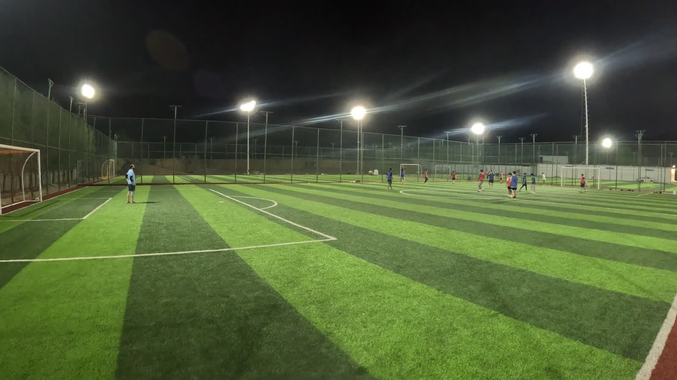
FINAL REVIEW
1/2 Lens VAR
Affordable instant-replay for football pitches — built for Riyadh.
The system, the AI results, the button decision, cost and next steps.
Final review · 17 August 2026
Notes:
Final review of 1/2 Lens VAR: what it is, what is built and live, how the AI performed, the button we chose, cost, risks and next steps.

Slide 2
THE PRODUCT
Press a button. Watch the last 30 seconds.
1
2
3
A camera films the pitch
A player presses the button
Watch & share
One wide camera keeps a constant rolling 30-second buffer of play.
A button by the goal saves the last 30 seconds instantly.
It plays on their phone in seconds, with a shareable link.
Instant replay needs no AI — it runs on-site on affordable hardware and works today.
Notes:
The core product is simple: a rolling 30-second buffer, a button, and instant playback on a phone. Already running.

Slide 3
STATUS
Where the project stands today
App LIVE 24/7
AI ball detection
Button chosen
Setup priced
Deployed to a free Oracle cloud VM (in-Kingdom). Runs with no laptop.
From 0% at a bad angle to 72% on a real match after tuning.
A weatherproof metal button + the trigger code, both ready.
2-camera / 2-button field fully costed with buy links.
A working product online, an honest read on the AI, and a hardware plan ready to buy.
Notes:
Four pillars: live app, field-tested AI, chosen button, costed setup.

Slide 4
CAMERAS
The right camera — one rule to remember
DS-2CD… = IP camera ✓
DS-2CE… = analog ✗
• Gives an RTSP video stream the app can read
• Old coax/DVR type — looks similar in the box
• Runs over one network cable (PoE)
• No RTSP stream — the app cannot use it
• This is the family we buy
• Avoid, even though it is cheaper
Pick: 4K Hikvision IP bullet, heat/rain/dust rated (IP66/IP67), for evening play.
One letter decides it: CD works, CE does not.
Notes:
The single most useful rule at the store: DS-2CD is the IP camera we want; DS-2CE is analog and cannot stream to the app.

Slide 5
THE AI
Ball detection: from unusable to 72%
What the numbers mean
72%
At a low corner angle the ball is hidden behind players — the AI saw it almost never.
49%
A cleaner clip took it to 49%. Cropping the sideline and fixing the model pushed it to 72% — nearly 3 of every 4 frames.
0%
Low corner
angle
GoPro clip
(raw)
After left-crop
+ fixes
Camera height and angle matter more than the model — a high, central mount is the fix.
Notes:
The detection story: bad angle ~0%, decent clip 49%, and 72% after cropping distractions and fixing the class filter. The lesson is that mounting position drives accuracy.

Slide 6
WHAT CHANGED
Three fixes that raised accuracy
1
2
3
Cropped the sideline
Fixed the model
Ignore anything still
Cut the left edge (the fence net) out of frame so the follow-cam stops locking onto distractions instead of the ball.
Stopped it counting "baseball bat" and "baseball glove" as a ball — a real source of false hits.
If a spot does not move for a few seconds it is not the ball (a cone, a bag, a light) and is dropped.
Same footage, +23 points — before spending anything on new hardware.
Notes:
Three concrete, no-cost software changes lifted detection from 49% to 72%.

Slide 7
THE BUTTON
It is just a button — here is the chain
1
2
3
4
Player presses
→
Signal to the mini-PC
→
App saves 30s
→
Clip on the phone
A weatherproof button by the goal.
Over a cable, Wi-Fi, or a radio receiver.
It cuts the last 30 seconds from the buffer.
Plays in seconds, with a share link.
The button has no camera and no screen. The camera you already have does the filming.
A small trigger script (written and saved) turns the press into a saved clip.
Notes:
The button is only a trigger. A small listener script already written converts a press into a call to the app's replay endpoint.

Slide 8
OPTIONS
Four ways to trigger a clip
RF doorbell button
Wi-Fi button (Shelly)
Flic Bluetooth
Wired metal button
Weatherproof radio button + one USB receiver. Cheapest, long range.
Sends the request straight to the app over Wi-Fi. Clean, no receiver.
The polished padel-style button. Needs a small hub.
A physical switch on a cable — the most reliable, our pick.
~90–160 SAR / 2
~190–240 SAR / 2
~500–600 SAR
~120–160 SAR / 2
All four work with the app. The choice is weatherproofing, range and feel.
Notes:
Four trigger options, all compatible. Trade-offs are cost, range and weatherproofing.

Slide 9
THE BUTTON
The button — two options
FOR TESTING
≈ 80 SAR
FOR THE PITCH
100 mm USB dome
APIELE 22 mm mushroom (sealed)
IP65 weatherproof metal — heat, dust, rain.
Momentary — two wires to a small board.
For the permanent outdoor install.
About 40 SAR on Amazon.sa.
• Plugs straight into USB — no board, no wiring
• Big smack dome · momentary microswitch
• Works with the trigger script as-is
• Indoor · 2 m cable — perfect for a demo
≈ 40 SAR
Amazon.sa · APIELE mushroom (B09KZK8SXQ)
Test with the plug-and-play USB dome; switch to the sealed mushroom outdoors.
Notes:
Two buttons: for testing, a 100mm USB dome that plugs straight in (no board) and works with the trigger script; for the permanent outdoor install, the sealed IP65 APIELE 22mm mushroom wired via a small board.

Slide 10
THE BRAIN
The always-on computer
Why this box
HP
HP ProDesk 600 G1
Desktop Mini (refurbished)
Only needed for 24/7 — the laptop proves the prototype first.
Plenty of power for the video + 30s buffer.
Cheap & available — a fraction of a new mini-PC.
Tip: add an SSD (~120 SAR) later for speed.
• Intel Core i5-4590T · 8GB RAM · 500GB
• Tiny, low-power — built to run 24/7
• 2-year warranty (buys peace of mind)
• Runs the same app you already deployed
≈ 540 SAR
Amazon.sa · HP ProDesk 600 G1 DM (refurbished)
A ~540 SAR refurbished HP mini — only for the permanent 24/7 install.
Notes:
The 24/7 box: a refurbished HP ProDesk 600 G1 DM (i5-4590T, 8GB, 500GB, 2-yr warranty) for about 540 SAR on Amazon.sa. Only needed once you leave it running unattended; the laptop covers the prototype.

Slide 11
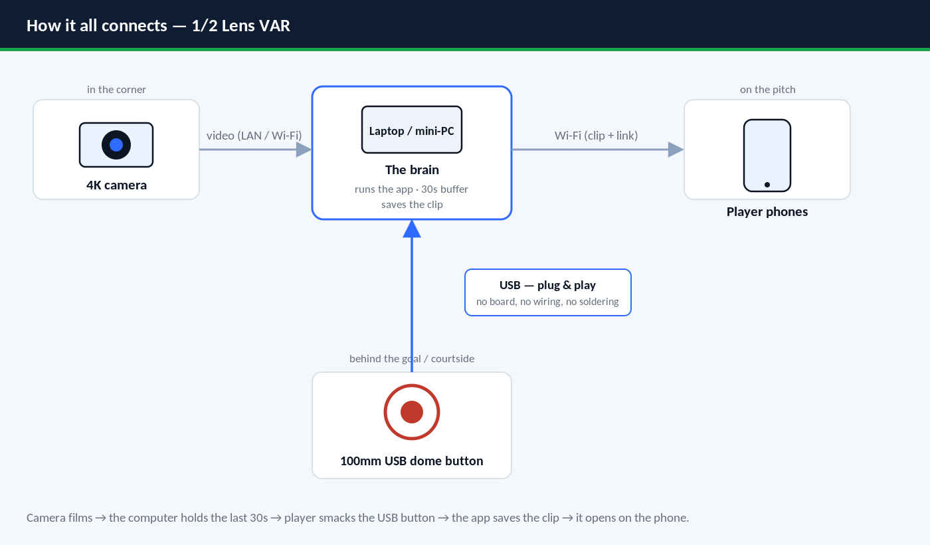
WIRING
Exactly how it connects
Notes:
The exact connection: the camera feeds the computer over LAN/Wi-Fi; the computer holds the 30s buffer and serves clips to phones over Wi-Fi. The USB dome button plugs straight into the computer — no board — and the app saves the clip on the press.

Slide 12
SHOPPING LIST
What we chose today
Cameras (×2)
Hikvision DS-2CD2683G2-LIZS2U — 4K varifocal 2.8–12mm
1,294.90 SAR
NVR
DS-7604NXI-K1/4P — 4-ch PoE (powers the cameras)
364.55 SAR
Computer (brain)
Raspberry Pi Zero 2W kit · runs the app on-site
270.25 SAR
Buttons
USB test dome (86) + outdoor IP67 mushroom (~140)
~226 SAR
A full 2-camera pitch kit secured for about SAR 2,000 — no subscription.
Notes:
The consolidated shopping list with the actual purchased items and prices.

Slide 13
PROGRESS
Where we are — what’s ordered
Cameras ×2
1,294.90 SAR
ARRIVED
Hikvision DS-2CD2683G2-LIZS2U · 4K varifocal 2.8–12mm
NVR
364.55 SAR
ARRIVED
DS-7604NXI-K1/4P · 4-ch PoE (powers the cameras)
Raspberry Pi
270.25 SAR
ON THE WAY
Zero 2W kit · runs the app on-site
USB test button
86.42 SAR
ON THE WAY
62mm USB dome · plug & play
Outdoor button
~140 SAR
TO BUY
IP67 mushroom (LAY37) · self-reset
Cameras + NVR in hand; Pi & button en route; just the outdoor mushroom left to buy.
Notes:
Status of the hardware: the two varifocal cameras and the PoE NVR have arrived; the Raspberry Pi and the USB test button are on the way; the weatherproof outdoor mushroom button is still to buy. The NVR has built-in PoE so it powers both cameras.

Slide 14
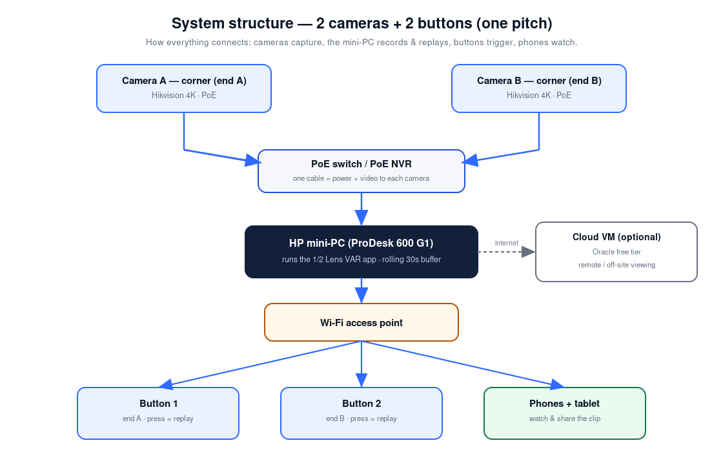
FULL SYSTEM
The 2-camera network
Two corner cameras → mini-PC (30s buffer) → Wi-Fi → buttons behind the goals & phones.
Notes:
End-to-end: cameras to a mini-PC holding the buffer, out over Wi-Fi to the goal buttons and players' phones. Runs on-site.

Slide 15
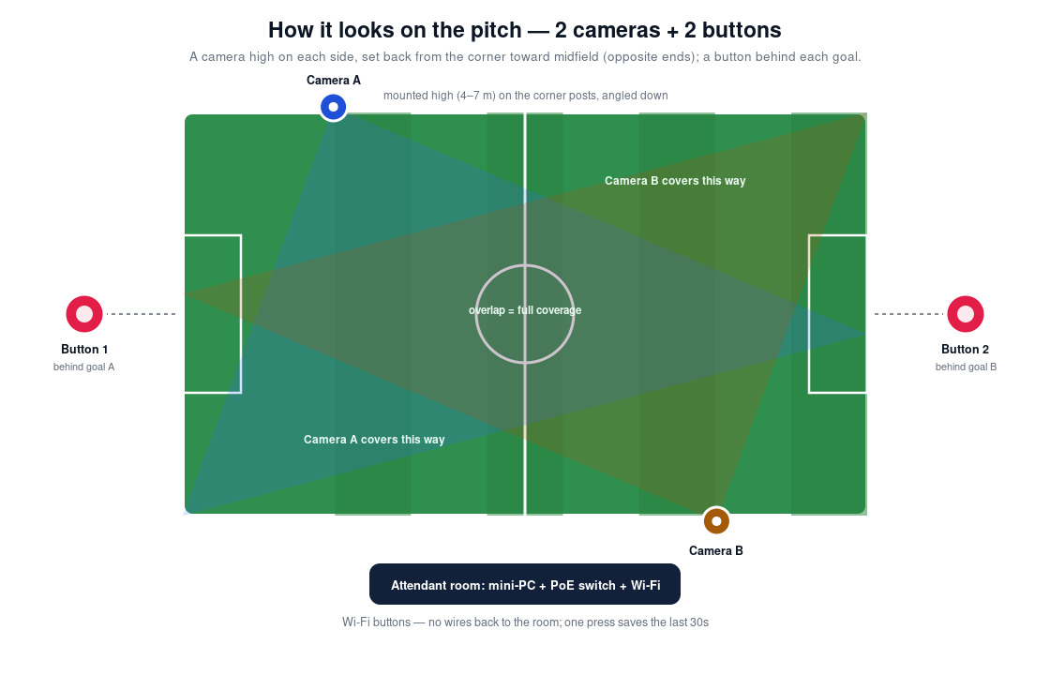
ON THE PITCH
Where everything sits
Cameras in the corners for full coverage; buttons behind each goal within reach of players.
Notes:
Cameras at the corners give overlapping coverage; the two buttons sit behind the goals.

Slide 16
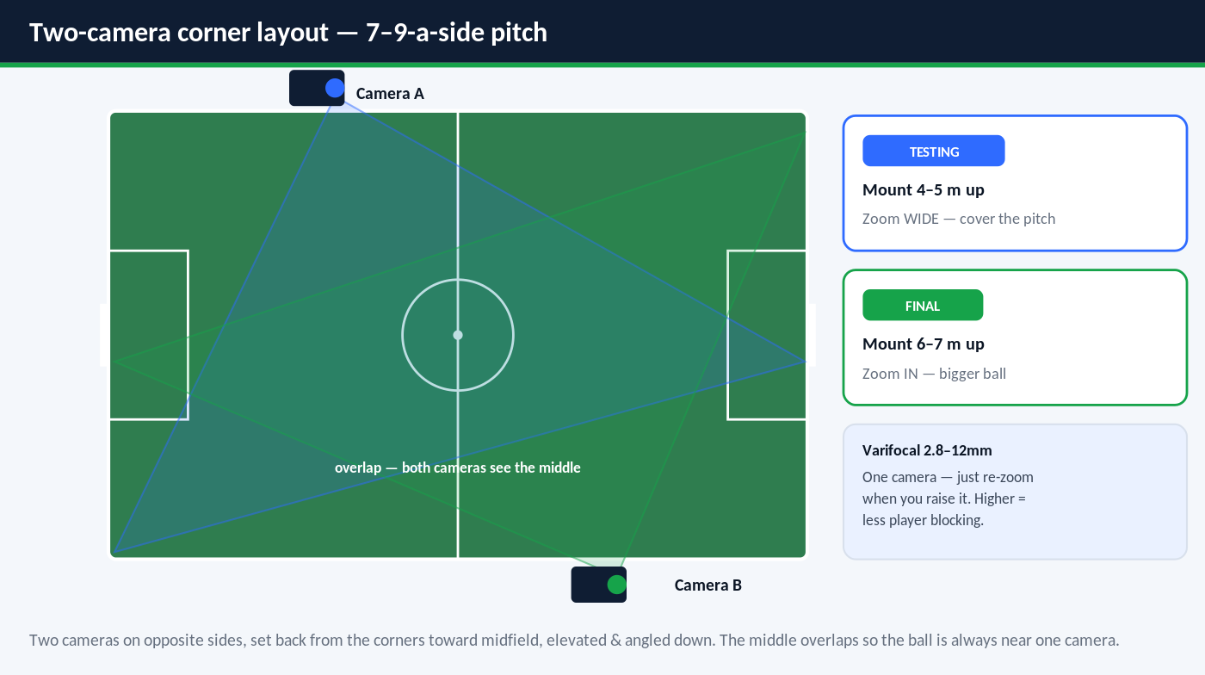
CAMERA PLACEMENT
Two cameras, opposite sides
Notes:
For a 7-9-a-side pitch: two varifocal cameras on opposite sides, set back from the corners toward midfield, elevated and angled down. Each covers its half with the middle overlapping. Mount 4-5m and zoom wide for testing, then 6-7m and zoom in for the final install — higher means players block the ball less.

Slide 17
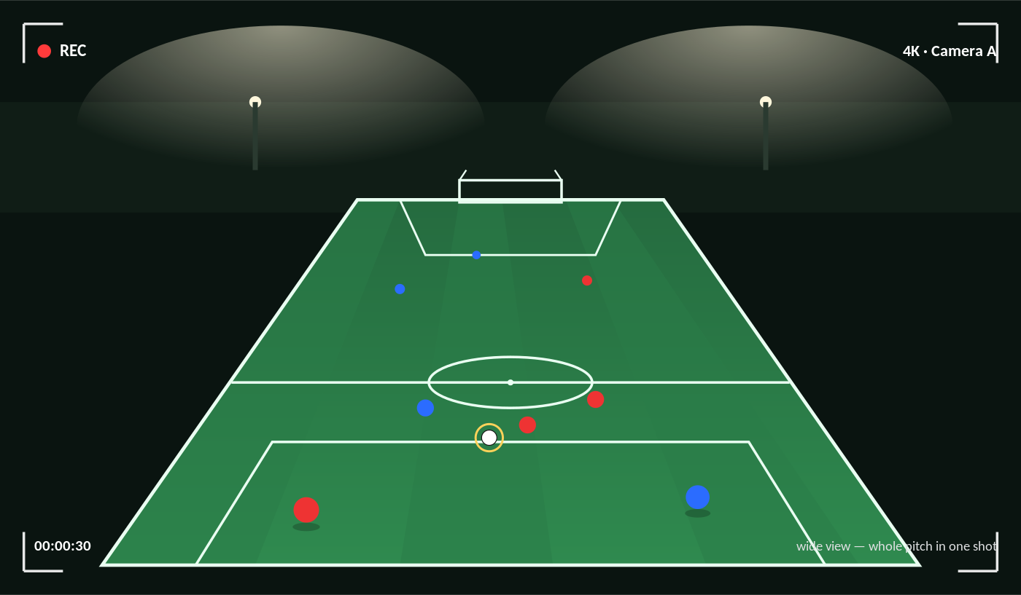
THE VIEW
What the camera will show
One wide 4K shot of the whole pitch — press the button to save the last 30 seconds.
Notes:
An illustration of the camera view: a wide 4K perspective of the pitch from an elevated side mount, capturing all the players and the ball in one shot. This is what a replay clip will look like.

Slide 18
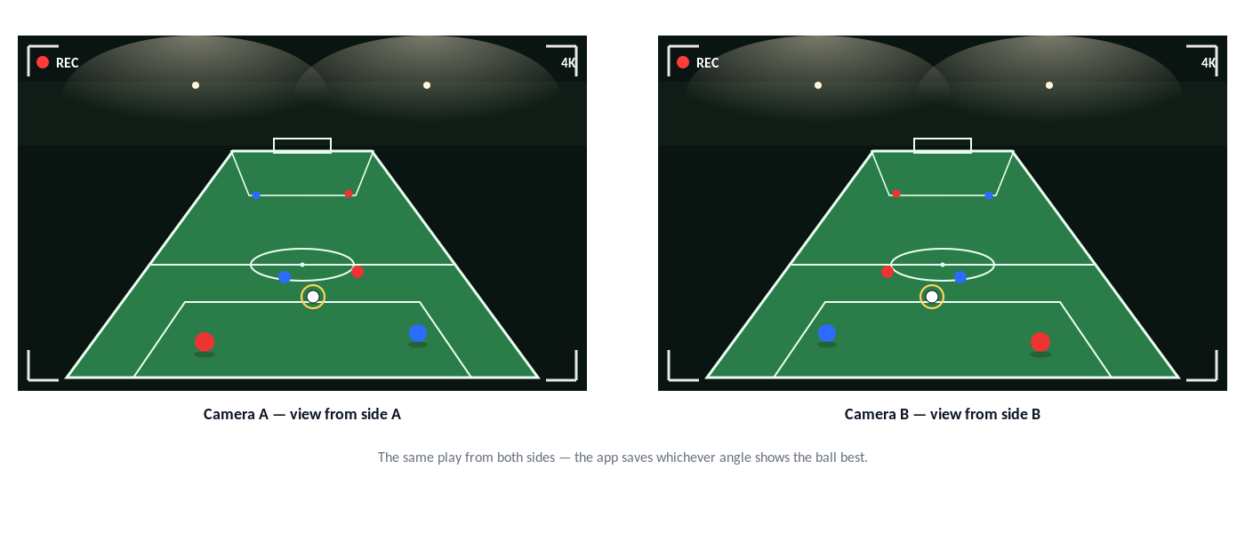
THE VIEW
How both cameras see the field
Two angles from opposite sides — the app keeps whichever shows the ball clearest.
Notes:
The two cameras on opposite sides give two views of the same moment. Together they cover the whole field, and the app can save whichever angle shows the ball best for the replay.

Slide 19
TO SORT OUT
Install points on a KSA pitch
1
Power & wiring
Pitches here already have mains power at the floodlight poles / control room — house the NVR + Pi there and run camera cables along the fence in outdoor, UV-rated conduit (harsh sun).
2
Button placement
Don’t mount it dead-behind the goal — that’s the ball-strike zone. Put it on the side fence ~2 m from the goal, chest height, out of the shot line: reachable, not a target.
3
Wiring cost
Outdoor Cat6 (~2–4 SAR/m) + conduit + connectors + an electrician to tap the floodlight power ≈ 400–800 SAR all-in.
4
Ethernet
One Cat6 run per camera to the NVR (its PoE powers them). Max 100 m per run — a pitch is well within it. Use outdoor, pure-copper Cat6; the Pi joins the NVR’s network.
5
Camera positioning
Two varifocal cameras on opposite corner poles, 4–7 m high, angled down and zoomed to frame each half; aim just below the floodlights to avoid glare.
The pitch already has power & a fence to mount on — most of the “plumbing” is half-solved.
Notes:
KSA install considerations: pitches have mains power at the floodlights (house the NVR/Pi there); keep the button off the shot line (side fence, not behind the goal); budget ~400-800 SAR for wiring; one Cat6 per camera to the NVR (PoE, <100m); mount cameras high on opposite corner poles, zoomed, below the floodlights.

Slide 20
COST
What a pilot field costs
First prototype — this week
≈ 80 SAR
Your laptop + existing GoPro + button + board
Budget 24/7 build
≈ 1,500 – 2,000 SAR
1 camera + refurb HP mini-PC (~540) + button (~40) + switch
Full 2-cam / 2-button field
2,400 – 4,800 SAR
2 cameras + HP mini-PC + UPS + 2 buttons + switch
Add AI follow-cam later
1,500 – 2,500 SAR
NVIDIA Jetson — phase 2, only once detection is proven
Start at ~80 SAR on your laptop; the ~540 SAR HP mini-PC is only for the 24/7 install.
Notes:
Indicative Riyadh pricing. Shared compute means additional pitches are cheaper.

Slide 21
TAILWINDS
What is working in our favour
✓
Proven demand Padel replay (PUSHIT, Veo) shows players and clubs pay for this.
✓
Open sport Small-sided football has almost no replay competitors — first-mover room.
✓
Cheap to run On-site hardware, free cloud tier — no per-court subscription needed.
✓
Already live A working product online 24/7, not just a slide.
✓
Low-risk pilot A free pilot night at a venue costs us almost nothing to prove it.
Notes:
Tailwinds: proven paid category, an open sport, low running cost, a live product, and a cheap way to pilot.

Slide 22
RISKS
What could go wrong — and the answer
!
Ball detection at bad angles — Mount high and central; instant replay needs no AI, so the button product ships regardless.
!
Outdoor weather & power — IP66/IP67 gear, a sun-shade, and a UPS for power blips.
!
Wi-Fi / range at the goal — Wired metal button avoids Wi-Fi; add an access point if needed.
!
Data / PDPL — Keep the cloud VM in a Saudi region; clips auto-delete after 24 hours.
!
Cost creep — Budget build and shared compute keep a pilot affordable.
Every known risk has a concrete, low-cost mitigation.
Notes:
Each risk paired with its mitigation — most importantly, the replay product does not depend on the AI.

Slide 23
NEXT
What comes next
1
2
3
4
Buy button + board
High, central mount
Free pilot night
Add the HP mini-PC
Order the mushroom button + a Pro Micro; test press → clip on your laptop.
Re-record from a proper height to confirm detection climbs further.
Run it live at one venue and capture player reactions.
For the always-on install, move it onto the ~540 SAR HP box.
A clear path from today to a live pilot — cheaply and quickly.
Notes:
Four next steps: buy the button, mount higher, run a free pilot, then decide on the follow-cam.

Slide 24
1/2 Lens VAR
A working, affordable replay product — live today, with a costed plan to pilot.
Press a button · watch the last 30 seconds · no subscription, no cloud lock-in.
Notes:
Close: a real product, live now, with a cheap and clear path to a pilot.

